Slide 1

Algorithm Analysis IT-2101
Dr. Mohammad Abu Yousuf
yousuf@juniv.edu

Slide 2
Sorting in linear time Introduction
Topic
Count Sort
Radix Sort
Bucket Sort

Slide 3
Count Sort
Counting sort is a sorting technique based on keys between a specific range. It works by counting the number of objects having distinct key values (kind of hashing). Then doing some arithmetic to calculate the position of each object in the output sequence.
Counting sort assumes that each of the n input elements is an integer in the range 0 to k, for some integer k. When k=O(n), the sort runs in ϴ(n) time.

Slide 4
Count Sort
In the code for counting sort, we assume that the input is an array A[1…..n], and thus A.length = n. We require two other arrays: the array B[1…..n] holds the sorted output, and the array C[0….k] provides temporary working storage.

Slide 5
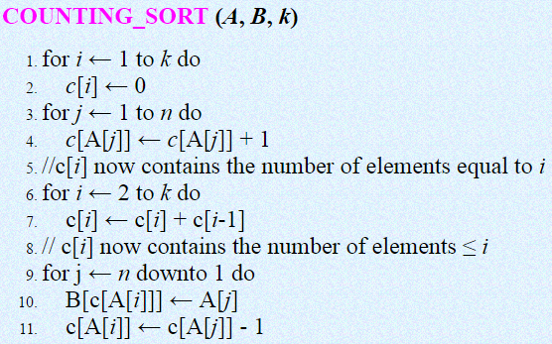
Count Sort
Here, we are given array A[1 . . n] of length n. We required two more arrays, the array B[1 . . n] holds the sorted output and the array c[1 . . k] provides temporary working storage.

Slide 6
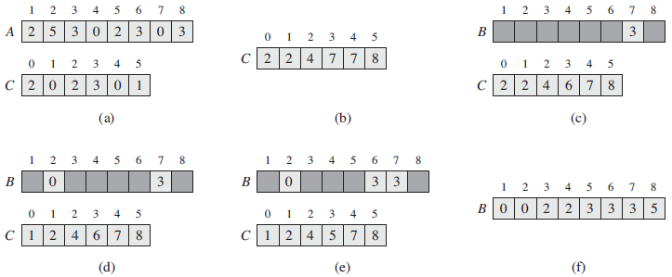
Count Sort
Illustration of count sort:

Slide 7
Count Sort
Figure (Previous slide)The operation of COUNTING-SORT on an input array A[1….8], where each element of A is a nonnegative integer no larger than k = 5.
(a) The array A and the auxiliary array C after line 4.
(b) The array C after line 7. Lines 6–7 determine for each i=0, 1,…., k how many input elements are less than or equal to i by keeping a running sum of the array C.
(c)–(e) The output array B and the auxiliary array C after one, two, and three iterations of the loop in lines 9–11, respectively. Only the lightly shaded elements of array B have been filled in.
(f) The final sorted output array B.

Slide 8
Count Sort
Analysis:
Counting sort assumes that each of the elements is an integer in the range 1 to k, for some integer k.
The loop of lines 1-2 takes O(k) time
The loop of lines 3-4 takes O(n) time
The loop of lines 6-7 takes O(k) time
The loop of lines 9-11 takes O(n) time
Therefore, the overall time of the counting sort is O(k) + O(n) + O(k) + O(n) = O(k + n)

Slide 9
The Radix Sort Algorithm
Example 1: Original, unsorted list:
170, 45, 75, 90, 802, 24, 2, 66
Sorting by least significant digit (1s place) gives: [Notice that we keep 802 before 2, because 802 occurred before 2 in the original list, and similarly for pairs 170 & 90 and 45 & 75.]
170, 90, 802, 2, 24, 45, 75, 66
Sorting by next digit (10s place) gives:
802, 2, 24, 45, 66, 170, 75, 90
Sorting by most significant digit (100s place) gives:
2, 24, 45, 66, 75, 90, 170, 802

Slide 10
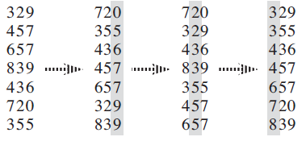
The Radix Sort Algorithm
Example 2:

Slide 11

The Radix Sort Algorithm
The following procedure assumes that each element in the n-element array A has d digits, where digit 1 is the lowest-order digit and digit d is the highest-order digit.

Slide 12
Bucket sort
Bucket sort assumes that the input is drawn from a uniform distribution and has an average-case running time of O(n).
Like counting sort, bucket sort is fast because it assumes something about the input.
Whereas counting sort assumes that the input consists of integers in a small range, bucket sort assumes that the input is generated by a random process that distributes elements uniformly and independently over the interval [0, 1)

Slide 13
Bucket sort
Bucket sort divides the interval [0, 1) into n equal-sized subintervals, or buckets, and then distributes the n input numbers into the buckets.
Since the inputs are uniformly and independently distributed over [0, 1), we do not expect many numbers to fall into each bucket.
To produce the output, we simply sort the numbers in each bucket and then go through the buckets in order, listing the elements in each.

Slide 14
Bucket sort
The code for bucket sort assumes that the input is an n-element array A and that each element A[i] in the array satisfies 0 ≤ A[i] < 1. The code requires an auxiliary array B[0……n-1] of linked lists (buckets) and assumes that there is a mechanism for maintaining such lists.

Slide 15
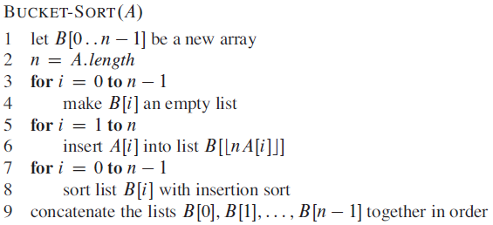
Bucket sort

Slide 16
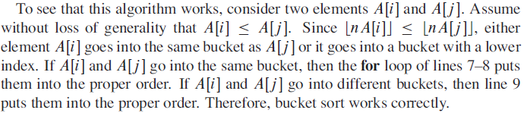
Bucket sort

Slide 17
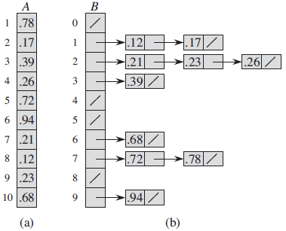
Illustration of bucket sort
Figure shows the operation of bucket sort on an input array of 10 numbers.

Slide 18

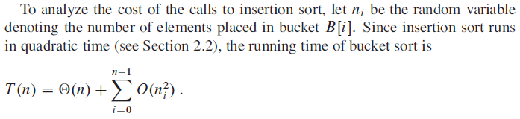
Running time of bucket sort

Slide 19
Thank you

